Slide 1
OPENER
What is denser a pound of feathers or a pound of bricks? Complete Comparing Cubes

Slide 2
OPENER
Complete Comparing Cubes

Slide 3
It Sinks, It Floats
Controls, Variables, Graphing skills

Slide 4
Content Objectives
Review of controls, variables and graphing
Learn how to make accurate measurements Understand how a graph can help you make sense of your evidence
Calculate slope and percent error
Experimentally determine the density of a liquid and various solids
Practice Lab Safety

Slide 5
Language Objectives
Summarize your findings based on evidence
Create and interpret your density graph
calculate slope
write an explanation of what your graph shows

Slide 6
Density Defined
Ratio of the mass of a substance compared to its volume or mass per unit volume
Expressed as grams per cubic centimeter (g/cm³ for solids or g/mL for liquids)
Remember: 1mL = 1cm³ = 1cc

Slide 7
Density Equation
Formula: D =m / V
D = Density
m = Mass
V = Volume
g/cm³ for solids or g/mL for liquids
Remember: 1mL = 1cm³ = 1cc

Slide 8
Components of Density: Mass
MASS: Measure of the amount of matter in an object
Measured in grams (g) using a digital scale or triple beam balance

Slide 9
Components of Density: Volume
VOLUME - the 3 dimensional space occupied by a substance
Volume can be quite easily calculated for some regularly shaped objects. You have probably used the formulas
length x width x height = volume_{cube}
4/3 л r³ = volume_{sphere}

Slide 10
Density Examples
A rock is more dense than a crumpled piece of newspaper of the same size.
A oil is less dense than water.
Notes:
Have examples of substances with different densities out
Orange – alc and h2o
Block with holes

Slide 11
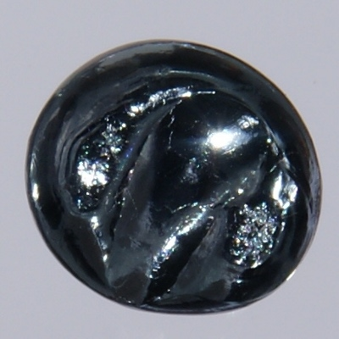
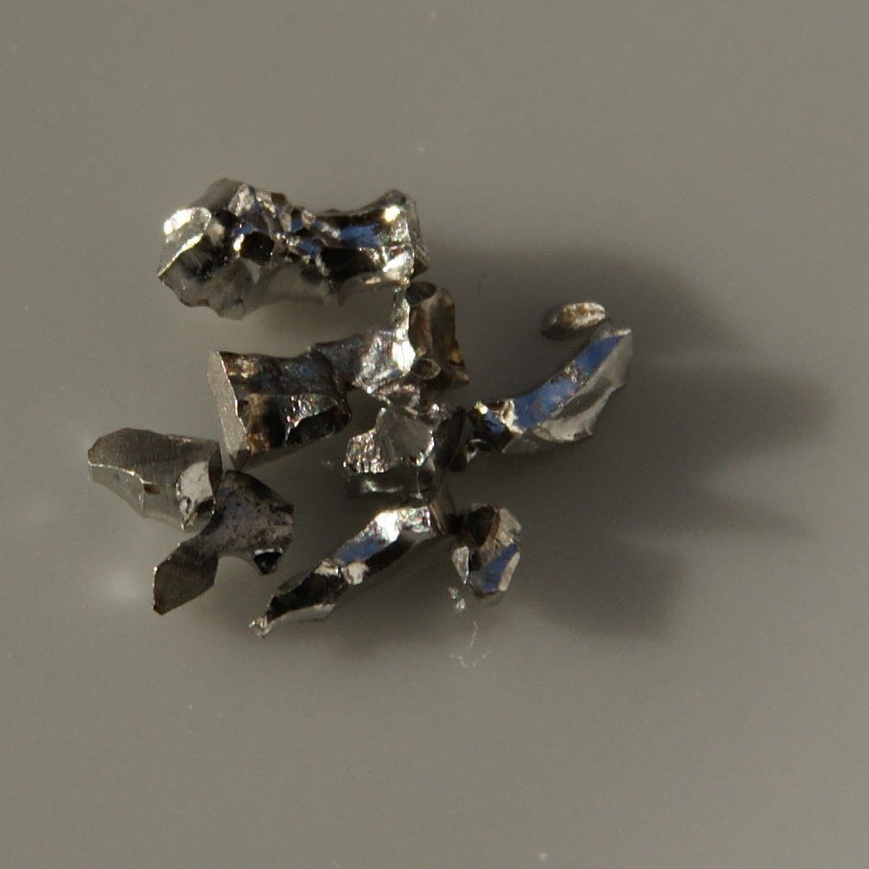
Density– Sample problem
If the mass of a piece of osmium (Os) is 45 grams and it displaces almost 2.0 mL of water when fully submerged, calculate the density of osmium.
Note: Osmium and iridium (Ir) are the densest of the elements. Osmium has a density of 22.61 g/cm³ (that’s about twice the density of lead)
Iridium
Osmium

Slide 12
SOLUTION
D = m/V
D = 45 g/2 mL
D = 22.5 g/ml g/cm³
Note: Osmium and iridium (Ir) are the densest of the elements. Osmium has a density of 22.61 g/cm³ (that’s about twice the density of lead)

Slide 13
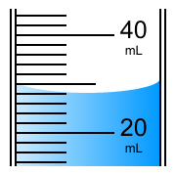
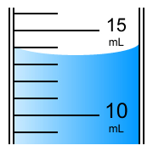
How to measure volume
What volume is shown in the graduated cylinder below?
A. 20.4 mL
B. 24.0 mL
C. 28.0 mL
D. 30.0 mL
What volume is shown in this graduated cylinder?
A. 10.4 mL
B. 13.5 mL
C. 14.0 mL
D. 17.0 mL

Slide 14
How to Measure
Remember: For most tools that are not digital, estimate one digit past the last mark on the scale.

Slide 15
Calculate the density of 10 mL of Water
Measure mass and volume of 10 mL of H₂O
Use D = m/V to calculate density.

Slide 16
More on Iridium and Osmium
Osmium and iridium were discovered at the same time by the British chemist Smithson Tennant in 1803. Osmium and iridium were identified in the black residue remaining after dissolving platinum ore with aqua regia, a mixture of 25% nitric acid (HNO₃) and 75% hydrochloric acid (HCl). Today, osmium is primarily recovered during the processing of platinum and nickel ores.
Metallic osmium is hard, brittle and very difficult to make. Powdered osmium is easier to make but emits osmium tetroxide (OsO₄) when it is exposed to the air. Unfortunately, osmium tetroxide smells bad and is very poisonous. Because of these problems, osmium is primarily used to make very hard alloys. Osmium alloys can be found in ball point pen tips, fountain pen tips, record player needles, electrical contacts and other devices where frictional wear must be minimized.

Slide 17
Density Lab Part 1
Inquiry Question: What happens to the density of water as the volume of water increases?
Hypothesis: If… then …because…

Slide 18
Density Lab Part 1 PROCEDURE:
Mass your graduated cylinder. You will need this later.
Mass of graduated cylinder(s) = ________ _______
With a graduated cylinder, CAREFULLY measure about 10 mL of water. (Remember to consider meniscus)
Measure the mass of 10 mL of water on a digital scale.
Use the same procedures to measure the volumes and masses at 10 mL intervals to 100 mL of water. Record in data table., remember to subtract the mass(s) of the graduated cylinder(s)
Clear
Opaque

Slide 19
RemindeR
When setting up a data table the independent variable is placed in the _____________column and the dependent variable is placed in the ___________ column.

Slide 20
Density Lab Part 1 Density of Water Data Table (Create in your notebook)
Density of Water Data Table
Volume of H₂O (mL) | Mass of H₂O (grams) | Density Ratio Mass / Volume | Density g/mL
10.1 |  | /
21.0 |  | /
30.5 |  | /
Continue numbering by 10 to 100

Slide 21
HOMEWORK:
Set up a data table for the Density Lab
Set up columns for independent variable, dependent variable, Density ratio, and calculated density. Title your data table. Use a ruler for all lines. Include units.
You need rows for 10-12 trials

Slide 22
Controls and Variables
Control – A part of the experiment that is not being tested and therefore is kept the same.
Variable – Any part of the experiment that can vary/change.
Independent Variable – The part of the experiment
that is manipulated or changed by the person
performing the experiment. To determine the
independent variable, ask yourself “What am I
changing?”
Dependent Variable – The part of the experiment that
is affected by the independent variable. To determine
the dependent variable, ask yourself, “What am I
measuring?”

Slide 23
POE – Wooden Blocks
P
O
E
Notes:
After POE, revisit Comparing Cubes with your table partner, make any changes you need to.

Slide 24
Think Pair Share
What is your independent variable? What axis will you graph this on?
Dependent variable? Which axis?
What kind of graph should you make?
Should you plot your calculated density?

Slide 25
Making a Graph of your Data
Watch a beginner’s guide to graphing - BOZEMAN
http://www.youtube.com/watch?v=9BkbYeTC6Mo

Slide 26
Density Lab Graph Part 1
Plot a graph on graph paper with the independent variable on the x axis and the dependent variable on the y axis.
Follow the guidelines on the graphing rubric.
Self assess your graph

Slide 27
OPENER – day 2
Have HW out and ready to check
Measure the width of your lab table three times to the nearest 0.1 mm and write the data in your journal.
What do you notice about the data?
Compare your measurements to your partner’s. What do you notice?

Slide 28
Determining Volume by Displacement
Some irregularly shaped objects are difficult to measure so we can…. find the Volume by DISPLACEMENT
The volume of a solid (whether regularly or irregularly shaped) can be determined by fluid displacement.

Slide 29
How to find Volume by Fluid Displacement
meniscus – draw and label in your notes
Displacement – draw and label in your notes
REMEMBER:
1mL= 1cm = 1g for water at 4 degrees C
EUREKA video – Episode 25, Review of Volume and Density http://www.youtube.com/watch?v=GMNpPgLT8Fk
Gizmo for example

Slide 30
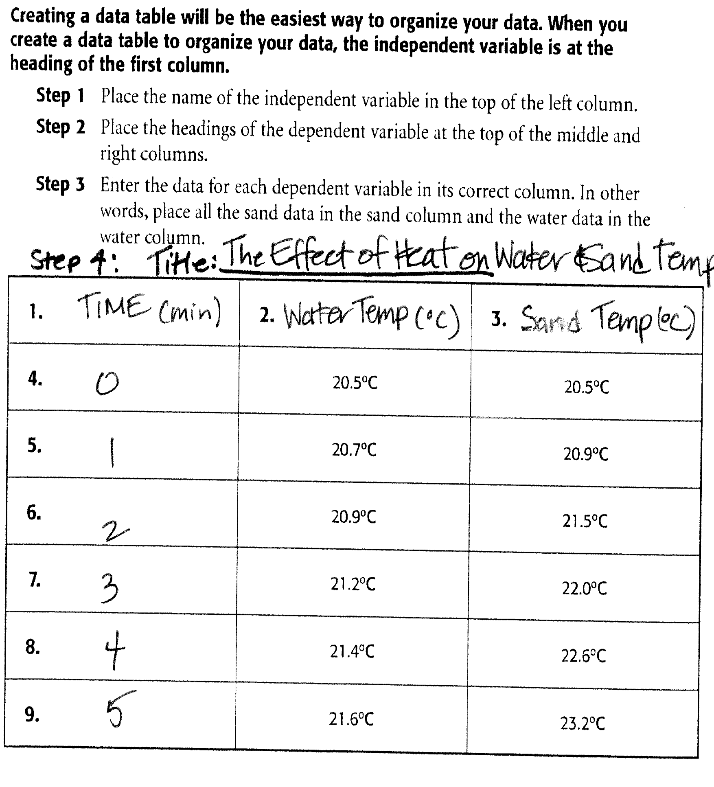

Slide 31
OPENER 10/3/13
Take out accuracy and precision homework.
CHECK YOUR WORK on back of sheet:
-5.59% (OK if you rounded to two digits)
-2.63 %
1.75%
Accurate? Yes Precise? no

Slide 32
Important Reminders:
You should be recording volume to the 0.1 mL
eg: 10.2 mL
You should be recording mass to 0.1 g
eg: 35.8 g
This means that you will be rounding your density to 3 digits eg. 0.998 g/mL

Slide 33
OPENER
The word density comes from the Greek word “dasus” which means what?
What is the accepted value for the density of water at 4 degrees C?
COMPACT
1.00 g/mL
(0.99897 g/mL) This is when water is at its most dense.
Notes:
What are the densities of water at temperatures higher and lower than four degrees C?

Slide 34
What is the accepted density of water at room temperature?
Pure water has a density of 0.99823 grams/mL at 1 atm pressure and a temperature of 20 degrees Celsius (68 degrees Fahrenheit).
Q & A: Density of water | Department of Physics | University ...
van.physics.illinois.edu/qa/listing.php?id=2163
Other accepted densities: http://honorsph.startlogic.com/honorsphysicalscience/labs/density_accepted_values.htm

Slide 35
What is slope?

Slide 36
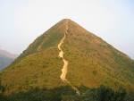
Which hill has a higher slope?

Slide 37
How do we calculate slope on a graph?
Choose any two points on the best fit line (best if they are not data points)
Label the first point (x₁, y₁)
Label the second point (x₂, y₂)
Use the slope equation to calculate the change in y (y₂ – y₁) divided by the change in x (x2 – x1)
y₂ ₋ y₁ Dy
x₂ ₋ x₁ Dx
SLOPE = m =
=

Slide 38
Density Lab - Slope
Calculate the slope of the best fit line on your graph. Show all calculations and equations on graph.

Slide 39
Percent Error analysis example Solve this problem
Formula:
actual(accepted) value – observed (experimental Value)
A student takes an object with an accepted mass of 200 g and masses it on his own balance. He records the mass of the object as 196.5 g. What is the percent error?
%E = a-o x 100
%E = 200g – 196.5g / 200g x 100
%E= 1.75%
x 100
actual value
a

Slide 40
Practice problem Formula: Known(actual) value – measured (experimental Value / actual value x 100
Working in the laboratory, a student finds the density of a piece of pure aluminum to be 2.5g/cm³. The known/accepted value for the aluminum is 2.699 g/cm³. What is the student’s percent error?
7.3%
Calculate your % error in the Density of Water lab?
Notes:
2.699 – 2.5 = .199 / 2.699 = .073 x 100 = %

Slide 41
Inquiry Question Paragraph - HW
Answer the inquiry question:
What happens to the density of water as the volume of water increases?
Explain your answer in detail using your evidence (How does your data table, your graph and today’s demo show that your prediction was right or wrong?)

Slide 42
Homework
Bring in 1-2 objects which will fit easily in and out of the 100 or 1000 mL graduated cylinders. Try to get a mix of objects you believe will sink and float in water.
Lab Conclusion - Write a complete paragraph answering the inquiry question using the CLEAR format

Slide 43
From Density Lab, Part 1:
CLAIM: Clearly write the answer to the inquiry question. (Reword the question you are trying to answer)
LEAD: Transition the claim to the evidence. Give background for, or tell what led up to your evidence. (Complete this after you state your evidence) Maybe ask yourself: What did you do to obtain your evidence?
EVIDENCE: My evidence showed…(summarize your data by sharing specific evidence supporting your claim) Cite specifics by referencing your data.
ANALYSIS: This is where you analyze and interpret your findings. Explain how the evidence proves or helped you form your answer. Reference graphs, patterns , illustrations – remember to analyze them in detail. Also share possible sources of error, including your error analysis and try to explain inconsistent data.
REVISIT CLAIM: Review your claim and important points

Slide 44
Density Lab Part 1 practice problem
A brick of salt measuring 10.0 cm x 10.0 cm x 2.0 cm has a mass of 433 grams. What is the density of the brick of salt?
First check for similar units of measure
Next calculate volume (l x w x h)
10 x 10 x 2 = 200 cm³
Then apply formula D = m/V
D = 433 / 200 = 2.165 g/ cm³

Slide 45
Opener 10/3/14
A question I still have about my homework is....
Be prepared to discuss.
Why does ice float? What if it didn’t?
https://www.youtube.com/watch?v=UukRgqzk-KE

Slide 46
OPENER 10/6/14
Read today’s procedure over silently at least twice.

Slide 47
OPENER 10/7/14
Check list - journal

Slide 48
What to do next
Paste your data table into your journal.
Take out your part I reflection/conclusion and be prepared to read it to your partner. Your group will decide which is the best reflection to share with the class.

Slide 49
Objective – part II of density lab
In chemistry, the density of many substances is compared to the density of water. You will plot the densities of objects as points on your existing density of water graph and look for patterns in the data.

Slide 50
Density Lab Part 2 Inquiry Question
Inquiry question: What are the ways we can determine if an object will float on water or sink in water?
Materials: graduated cylinder, digital scale, beaker, pipette, weighing tray, various objects
Notes:
(using calculations, a graph, or testing with water)

Slide 51
OPENER- Re read and Finish copying the Density Lab Part 2 Procedure
Complete first two columns. Be sure you make these predictions before moving on to the next step.
Find the volume of your objects with a formula (in your notes) or use the displacement method.
Using the correct balance, find the masses of each of the objects. DO NOT OVERLOAD!
Calculate the densities of 12 objects.

Slide 52
Density Lab Part 2 Procedure
5. Use the volume and mass for each of the objects to plot a data point on your graph from part I. Use a different color!
- Next to the data point plotted on the
graph put the name of the object in ()
along with the calculated density

Slide 53
Density Lab Part 2 It Sinks, it floats Data Table (Create in your notebook)
Name of Object | Prediction (S/F) | Test - Sink or Float? (S/F) | Mass (g) | Volume (mL) | Density (g/mL)
1. 5 glass marbles
2. steel
3. 2 pieces of wax
4. 2 rubber stoprs
5. 4 wood dowels
6. 5 styrofoam
7. 3 lead weights
8. 4 cork stoppers
9. chalk
10. 5 ____metal

Slide 54
OPENER
What is denser a pound of feathers or a pound of bricks?

Slide 55
SCHEDULE OF EVENTS AND DUE DATES
TODAY : FINISH ALL DATA, PLOT FINAL DATA POINTS
TOMORROW: GO for Part II is due at beginning of class
THURSDAY: Reflection for Density Lab Part II is due
FRI: shortened day
LONG WEEKEND
WEDNESDAY: FINAL DRAFT DUE!

Slide 56
What is the actual density of silver?
The actual density of silver (Ag) is 10.5 g/cm³

Slide 57
OPENER 10/7/13
What were you trying to find out in part 2 of the lab you did last week?
The purpose of part II of the lab was..
What happens when an object is less dense than water?
Why is it easy for people to float in the Dead Sea?
Why do heavy metal ships float?

Slide 58
EUREKA 26 BUOYANCY: Why do things float and sink?
Why do things float and sink?
TWIG – buoyancy video
http://www.twigcarolina.com/films/buoyancy-3613/

Slide 59
Short Video Review
MIT – best dotted lines
http://www.youtube.com/watch?v=l789l6np-qA
EUREKA EPISODE 25 Volume and Density
Twig Density varies w/temp and pressure
http://www.twigcarolina.com/films/glossary/density-4480/

Slide 60
BLOCK OF WOOD DEMO
v

Slide 61
Density Lab Part 2 Analysis of GRAPH
Write what your graph shows.
Look at the graph you created with the points representing the volume and mass of each of the objects plotted on it. What pattern do you see? Underneath or next to your graph, write your explanation for what you observe.
MIT – best dotted lines
http://www.youtube.com/watch?v=l789l6np-qA

Slide 62
Density Lab Part 2 Graph Analysis Continued
Would an object with a mass of 29 grams and a volume of 10 mL sink or float in water? Give evidence for your answer.
Would a 50 g piece of lead or a 50 g piece of Styrofoam displace more water when completely submerged? Give evidence for your answer.

Slide 63
COKE DEMO
How Much Sugar in a Coke?
http://www.youtube.com/watch?v=yKZ2ZqBYlrI

Slide 64
Short Video Review
MIT – best dotted lines
http://www.youtube.com/watch?v=l789l6np-qA
EUREKA EPISODE 25 Volume and Density
Twig Density varies w/temp and pressure
http://www.twigcarolina.com/films/glossary/density-4480/

Slide 65
HOMEWORK for It Sinks, It Floats Lab
Final edited reflection for part I of lab – finding the density of water –due tomorrow
Complete typed double spaced reflection for part II of the density lab – determining whether objects sink or float - due tomorrow
Have your reflections for part one and two printed and ready to turn in when you enter the classroom. No printing during class.

Slide 66
DENSITY QUIZ
Write the density equation or formula.
What is density? Define it.
Now explain density in your own words.

