Slide 1
OPENER: What do all living things need to survive?

Slide 2
HABITATS
What do we all need to survive?
Food, shelter, water, space
Habitat review
https://www.youtube.com/watch?v=MsoUZzGtoOs

Slide 3
Essential Questions
What makes a habitat?
How do animals adapt to live better in their habitats?

Slide 4
Today’s Objectives
What we will learn
How we will learn it
Explain and gives examples of how adaptations help animals live in different habitats
Watch a movie about adaptations and habitats
Discuss what animals need to survive
Make a mind map of the various habitats
Mind map examples of the adaptations that help animals and plants survive in the different habitats
Research and present a power point about habitats and adaptations

Slide 5
NOTES ON ADAPTATIONS
BEHAVIORAL ADAPTATION
PHYSICAL ADAPTATION
When a type of animal changes its behavior to better live in its habitat
When over time, an animal changes physically to better live (survive) in its environment

Slide 6
Presentation Requirements
Title Slide with title and your name
Definitions slide with definition of physical adaptation, behavioral adaptation and of habitat
Habitat example 1
Name of habitat
Where it is located (map?)
Name of animals in that habitat with adaptations that help them live there
Description of the adaptations and how they help the animal live (survive) in that habitat
Habitat example 2
Habitat example 3
(for higher grade, add more habitat slides)

Slide 7
GRADING
Make a minimum of
5 slides = 3
6 slides = 4
7 or more slides with no errors = 5

Slide 8
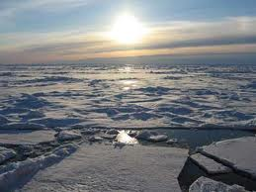
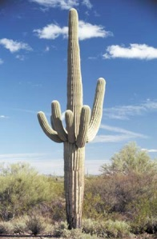
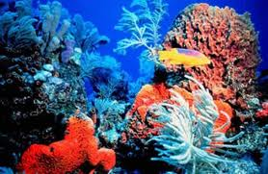
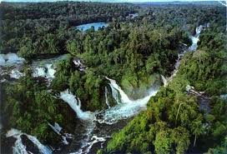
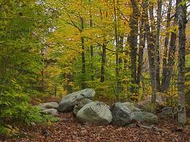
Websites
* All Habitats:
* Arctic Habitats
Habitats
Watch Animals in the Arctic
Google Earth
Animal Communities
Arctic Animals
*Desert Habitats:
* Ocean Habitats
Desert Safari
National Geographic Video 1
Desert Pictures
Ocean Video
Facts about the Desert
*Forest Habitats
A Furry Forest Friend
* Rainforest Habitats
Another Forest Friend
Rainforest Clip
Forest Animals
Australia Rainforest
This website will help you find the right habitat for some animals. It will help you see where some of the animals live.
Create a habitat

Slide 9
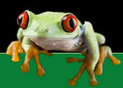
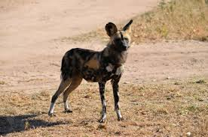
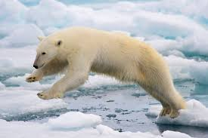
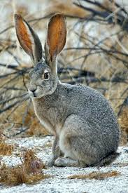
Sample presentation
TITLE: HABITATS AND ADAPTATIONS
By: Mrs. Kane

Slide 10
Definitions
Habitat: A place where an organism (living thing) lives
Physical Adaptation: Over time, an animal changes physically to better live (survive) in its environment. These changes are called physical adaptations.
Behavioral Adaptation: Over time, a type of animal can change its behavior to better survive in its environment. These changes are called behavioral adaptations.

Slide 11
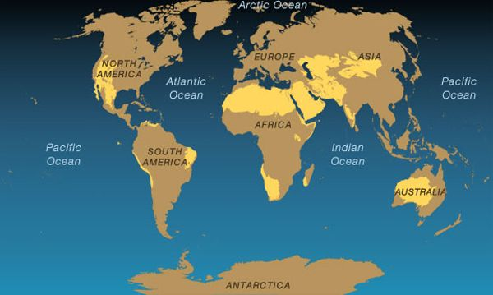
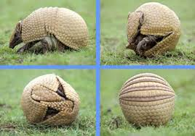
Desert Habitat
Description and location of desert habitat:
The desert habitat is dry and usually hot.
The desert habitats are found on the yellow areas on the map.
Example of desert adaptation:

Slide 12
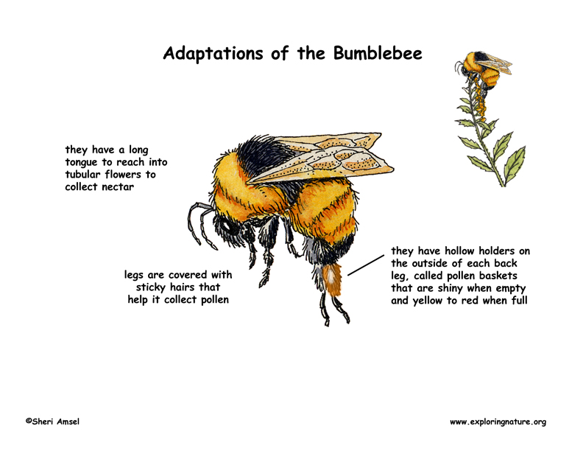
Grassland Habitat
Description and location of grassland habitat:
The grassland is…
Grasslands are found...
Example of Grassland adaptation:
Map of grasslands:

Slide 13
Coniferous Forest Habitat

Slide 14
Resources
http://www.u.arizona.edu/~bmg/Habitats.html

