Slide 1
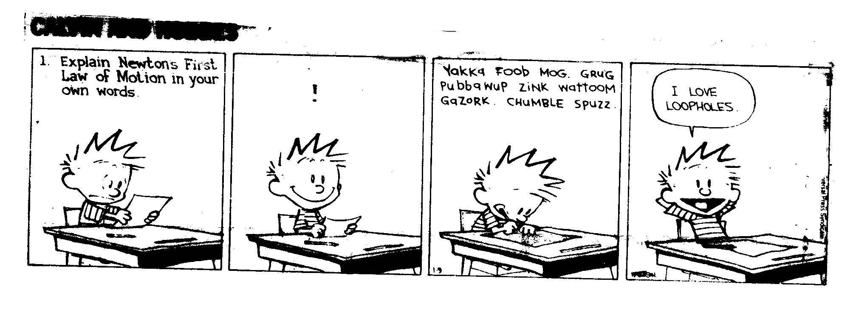
Complete GRAVITY EXIT SLIP from yesterday
Write any questions about gravity you may have!
Study guide for quiz will be posted on my website tonight under resources tab

Slide 2
TO DO LIST
Check GIZMO – Freefall Tower
Ask any questions you still have about gravity
Go over Gravity Exit Slip
Start INERTIA

Slide 3
NEWTON’S FIRST LAW of MOTION do reading

Slide 4
TO DO LIST
Find and ask any questions you have about gravity
Take quiz
Finished Early? Use time to read and if you have your book or your own copy, annotate Science matters reading on Motion

Slide 5
2) What picture best describes motion due to the force of gravity?
A
B
C

Slide 6
OPENER
You are playing with a spiral track from a marble maze. When you release the marble it spirals to the end then does which of the following?

Slide 7
Eureka – Defining mass as inertia
http://www.youtube.com/watch?v=1i5k5mW8qdI

Slide 8
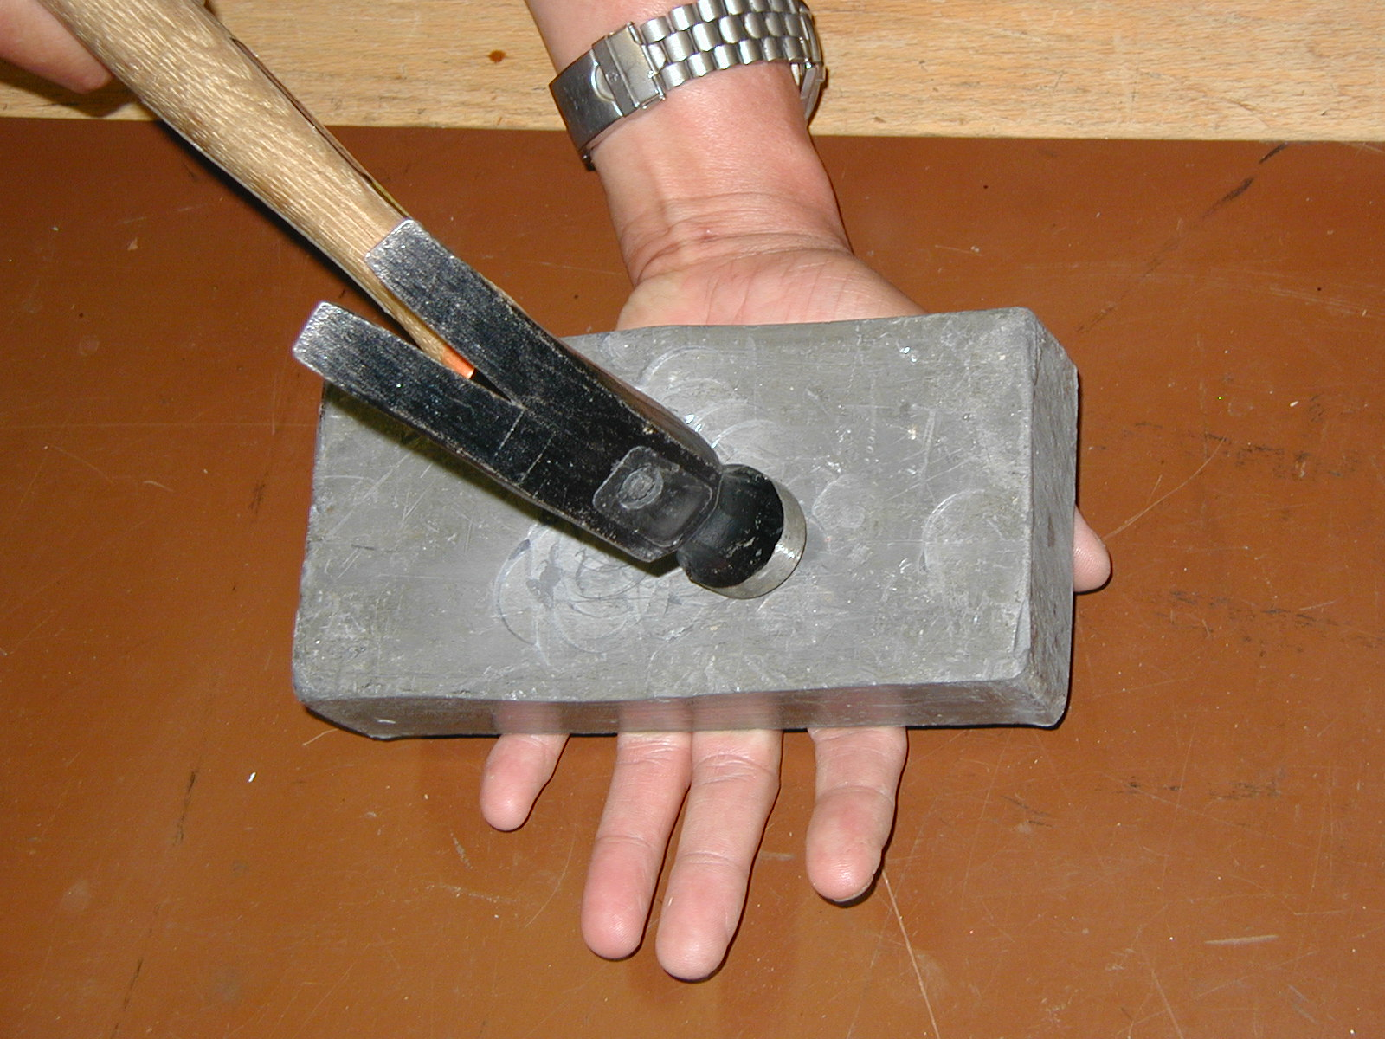
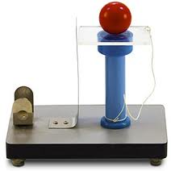
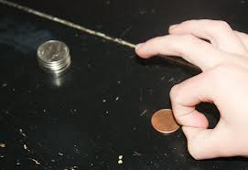
INERTIA DEMOS

Slide 9
OPENER
Think about a sport you like. Give an example of how Newton’s First Law of Motion applies to that sport.

Slide 10
NFL and INERTIA
https://www.youtube.com/watch?v=08BFCZJDn9w

Slide 11
Objectives
State Newton’s First Law of Motion
Define inertia
Give real world examples of Newton’s First Law
Conduct experiments that apply the First Law of Motion

Slide 12
NEWTON’S FIRST LAW of MOTION
Objects at rest will stay at rest and objects in motion will stay in motion in a straight line at a constant speed unless acted upon by an outside force.

Slide 13
NEWTON’S FIRST LAW
Also known as the law of inertia
Inertia: the tendency of things to continue in their present state of motion
http://www.youtube.com/watch?v=2QAVAdq5aAE
Eureka

Slide 14
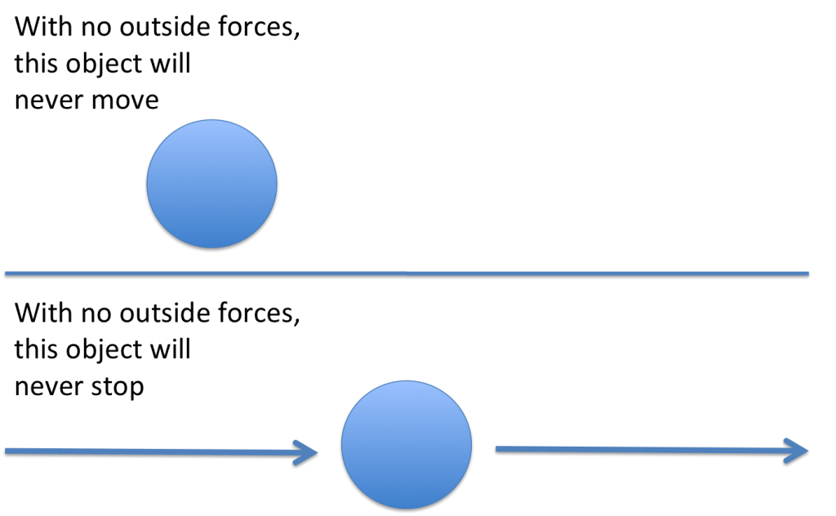
What does that mean? In a frictionless environment…

Slide 15
In other words…Inertia is “Laziness”
Things keep on doing what they are already doing!
Things at rest stay at rest
Things in motion stay in motion
(straight line, constant speed)

Slide 16
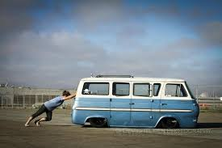
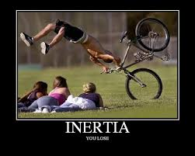
How do we measure inertia?
Inertia is a property of mass: (the more mass the more inertia)
Because of this, scientists use mass as a measure of inertia.
Eureka – Defining mass as inertia
http://www.youtube.com/watch?v=1i5k5mW8qdI

Slide 17
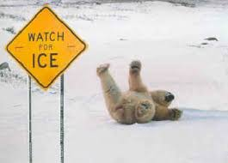
Why don’t we notice inertia on Earth?
FRICTION On Earth, the Force of Friction slows things down or they would keep moving
(also air resistance, collisions)
‘

Slide 18
EXAMPLES OF NEWTON’s FIRST LAW (Law of Inertia)
Inertia DEMOS

Slide 19
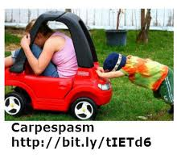
It takes a force to overcome inertia and make something move when it is motionless

Slide 20
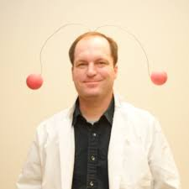
Inertia Hat

Slide 21
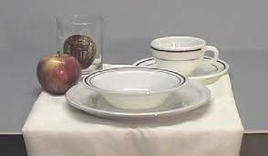
Examples
Tablecloth Trick

Slide 22
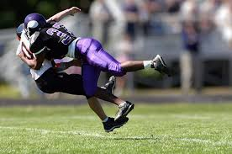
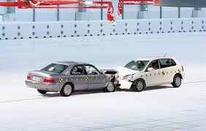
It also takes force to overcome inertia and stop something from moving
https://www.youtube.com/watch?v=08BFCZJDn9w

Slide 23
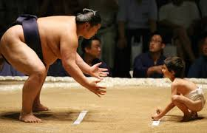
The more massive, the more force it takes to start or stop (small rock, small force: big rock, big force)

Slide 24
Inertia Beads
http://io9.com/this-is-the-bead-chain-experiment-its-about-to-melt-y-602029455

Slide 25
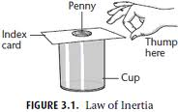
Penny in Cup DEMO – LAB TIME

Slide 26
Lab Tips
WEAR GOGGLES
CAREFUL with GLASSWARE
Find masses of coins BEFORE you begin!
Wipe down coins with tissue
Use a fresh card/no damage or dirt
Try a few practice shots before you start data
FLICK don’t PUSH

Slide 27
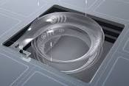
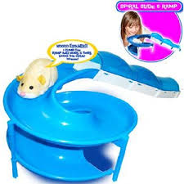
Explain the rolling ball in terms of inertia.

Slide 28
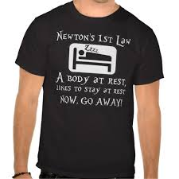

Slide 29
Opener
State Newton’s First Law of Motion (without peeking in notes)

Slide 30
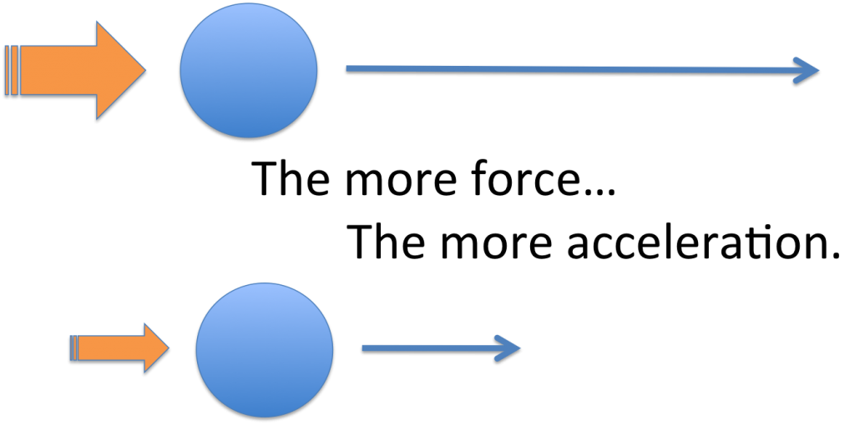
Newton’s Second Law

